Slide 1

Book Recommendation Team-4

Slide 2

Objective
To recommend the books according to the users by generating the features from the dataset

Slide 3
Exploratory data analsys

Slide 4
At first, import the required python libraries
-Pandas ((used for data analysis)
-Numpy (used for working with arrays)
-Matplotlib (used for visual representation like plotting graphs)
-Seaborn (used for data visualization and exploring data analysis

Slide 5
DATASET INFORMATION
The dataset is comprised of 3 csv files:-
-Books dataset
-Ratings dataset
-Users dataset

Slide 6
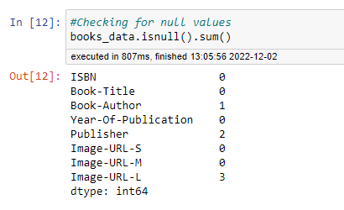
Insigths from Books dataset
There are 3 null value columns in the books_data
They are:- Book-Author
-Publisher
-Image-URL-L
So, drop these null value columns
from the dataset

Slide 7
Imputation of null values
Fill Nan values in the ‘Book-Author’ and ‘Publication’ with ‘No Mention’.
Why?
- Because we can’t replace Book-Author and Publisher with other names. So, using ‘No mention’ to fill the Nan values

Slide 8
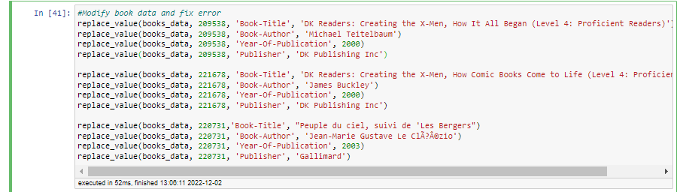
Correcting the mismatched columns
There are two string values i.e., DK Publishing and Gallimard are appeared in the Year-Of-Publication column.This leads to invalid results.
Lets make it correct by using the following code

Slide 9
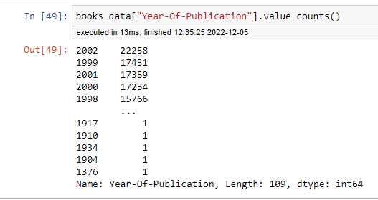
Treatment on Year of publication column
In the Year-Of-Publication columns, Years 0 & 2022 are invalid years. Replacing this invalid years with max year.
Max year in the Year-Of-Publication column is 2002. So, replace invalid years with 2002.
Why replacing with max year?
-Because most number of publications
takesplace in this year(2002). So, that’s
the reason to replace with max year.

Slide 10
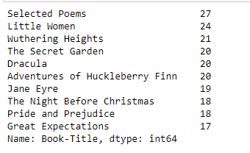
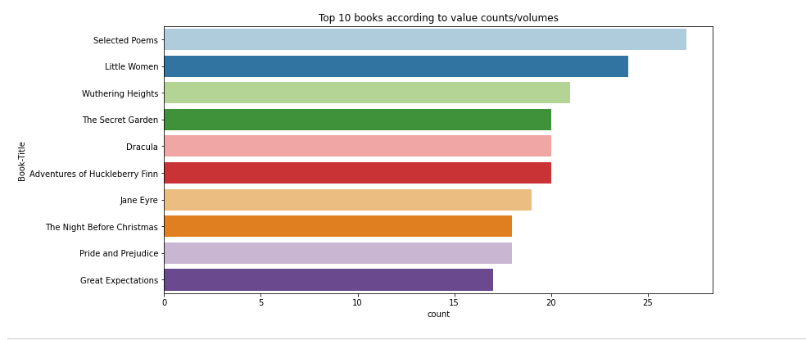
TOP 10 BOOKS ACCORDING TO VOLUMES
Selected poems has the highest no.of volumes(27), followed by Little Women,
Wuthering Heights …..acc. to given dataset

Slide 11
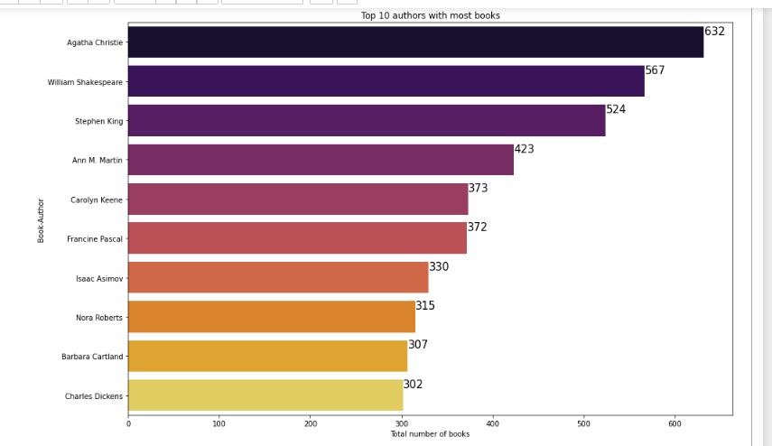
Top 10 authors with most no.of Books
Agatha Christie wrote the highest no.of books (632), then followed by
William Shakespeare,……….according to given dataset(Books).

Slide 12
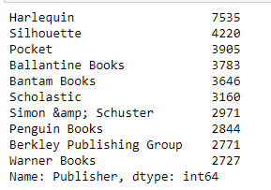
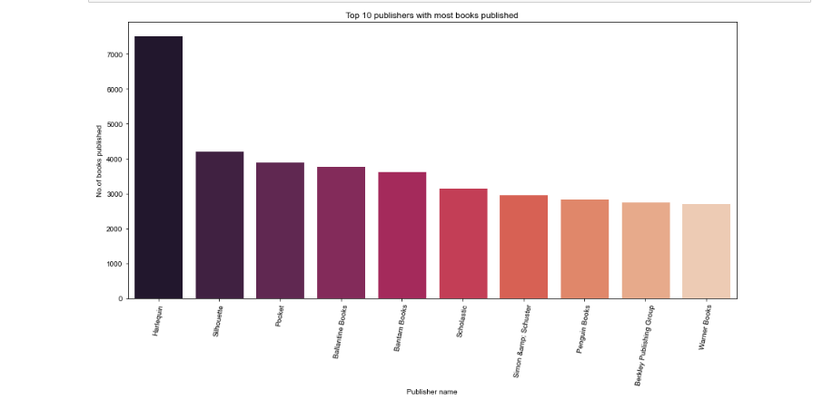
TOP 10 PUBLISHERS WITH MOST BOOKS PUBLISHED
Harlequin published highest no.of books (7535), followed by Silhoette, Pocket,….according to given dataset

Slide 13
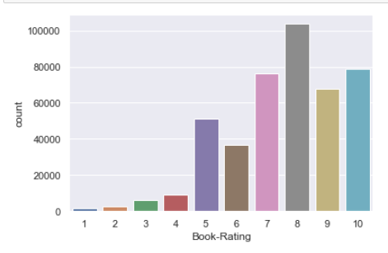
INSIGHTS FROM RATINGS DATASET
Ratings starts from 0 tom10
Ratings‘0’ means users doesn’t rate/read the book.
Ratings other than 0 i.e., from 1 to 10 means rated the book .
So, I divided ratings column into 2 categories.
-Ratings implicit(0-rating) and Ratings explicit(1-10 ratings).
Ignoring the Ratings implicit category, because
we can’t recommend books on 0 ratings.
Among the Ratings explicit(1-10), rating 8 has been
rated the highest no.of times

Slide 14
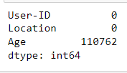
INSIGHTS FROM USERS DATASET
Age column has ~40% null values that means there are 110762 empty age values in the 278858(total age values) of users dataset.

Slide 15
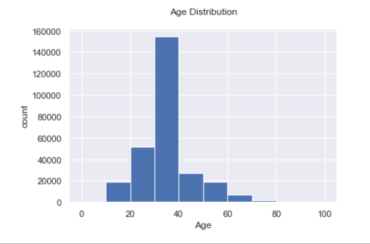
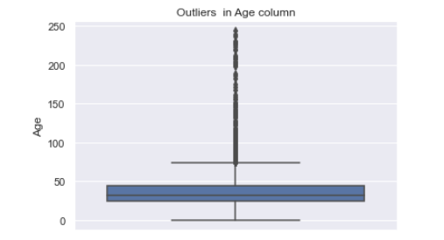
Outliers detection and Treatment of Nan values
Plotting a boxplot for age column to detect outliers .
By observing the boxplot, Age below 10 and above 80 can be treated as outliers.
Age has positive skewness, So we can use median to fill outliers and Nan values.
From distribution plot, most no.of users lies in between 30-40years of age.

Slide 16
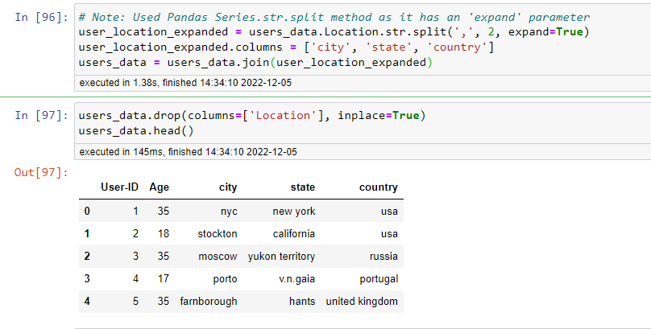
TREATMENT OF LOCATION COLUMN
Split the location column into City, State and Country columns by using the below code

Slide 17
IMPUTATION OF Country column
There are 4561 entries with empty stringsa and 2 Nan entries in the Country column.
So, replacing empty strings with Nan.
Why?
- Data type of country column is object , There is no other ways to replace empty string values. So that’s why replacing empty strings in the country column with Nan entries

Slide 18
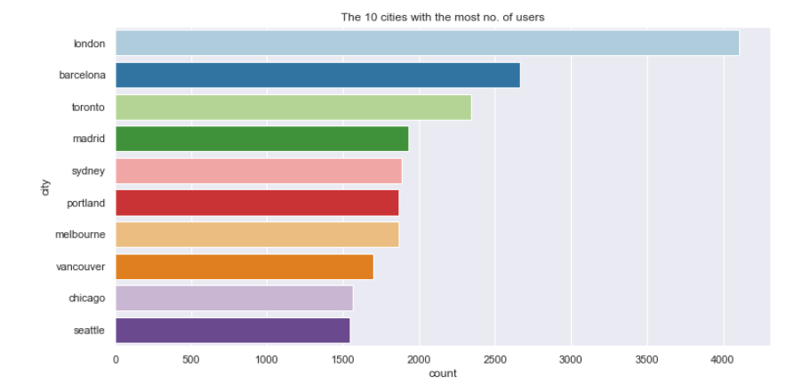
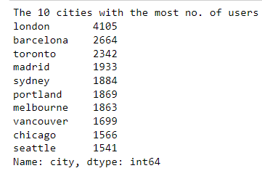
TOP 10 CITIES WITH MOST NO.OF USERS
London has the most no.of users (4105) among the Top 10 cities.

Slide 19
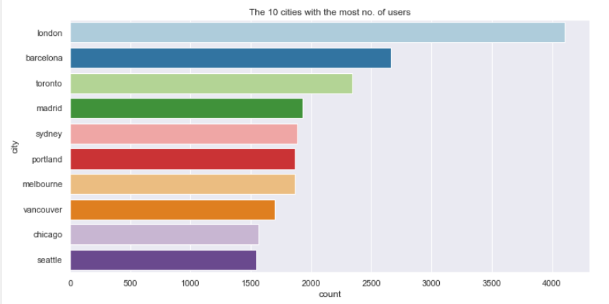
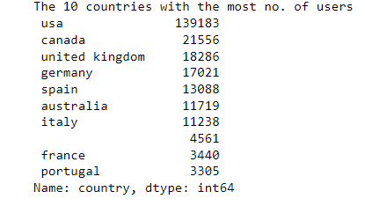
Top 10 countries with most no.of users
U.S.A has the most no.of users (139183) among the Top 10 Countries.

Slide 20
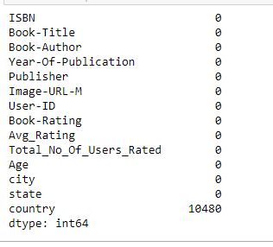
Merging datasets
After Data cleaning, merge three datasets on their respective similar columns.
After merging, the size of the dataset is 383842 rows and 14 columns.
Only Country column has the null values among the 14 columns

Slide 21
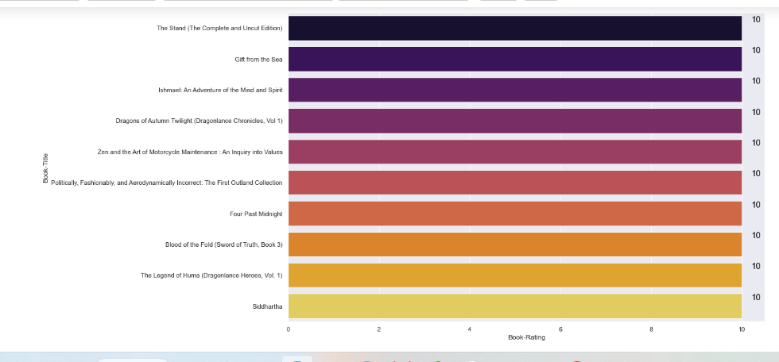
Top 10 Most rated books
The following books ‘The Stand(The Complete and Uncut Edition), Gift from the sea,….. got the highest ratings(10/10).

Slide 22
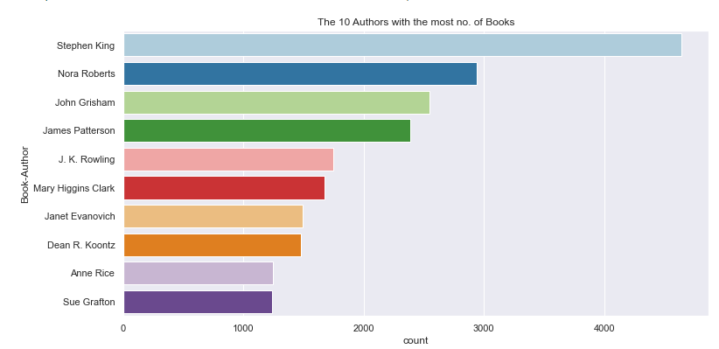
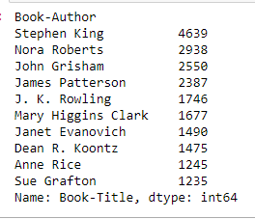
Top 10 most prolifc authors
Stephen King wrote the ,highest no.of books (4569), followed by Nora Roberts, John Grisham…….

Slide 23
Model building
1. Popularity Based Recommendation System
2. Collaborative Filtering
i. Book-Book Similarity
a. using book-title to get similar recommended books
b. using User-Id to get similar recommended books
ii. User – User Similarity using Cosine Similarity
a. using User-Id to get similar User’s -Id
iii. Using KNN with metric cosine
a. using index no. to get similar recommended books
b. using user-id to get similar recommended books

Slide 24
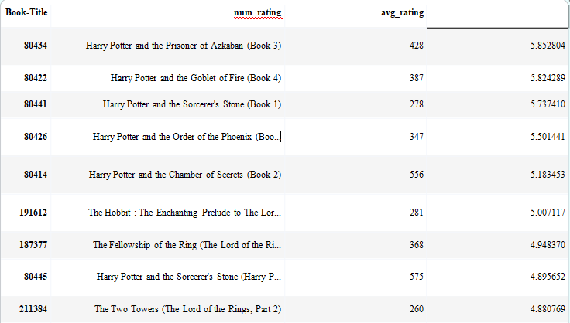
Popularity based recommender system
About 20 Most Popular Books:-
Criterion:- Books having more than or equal to 250 No. of ratings. Means at least 250 readers rate them.
No. of Books Having rating >=250 :- 186
Country from where these books belong:-
USA – 19
Others – 1
4. Book Readers age:-
0<age<20 :- 1
20<age<40 :- 10
40<age<60 :- 7
60<age<100 :- 2

Slide 25
Collaborative filtering
Criterion:-
Users who read or rate at least 200 books
Books which are rated by minimum 50 peoples
No. of unique Users who rated the books – 92106
No. of unique Users who rated more than 200 books – 811
No. of Books read by 50 or more users – 706
Shape of the data having users who rated >=200 books and read at least 50 books - (58586,10)
Out of these 58586 users , top five countries users-
USA- 49010
Canada- 4699
n/a- 947
United Kingdom- 940
Australia- 450

Slide 26
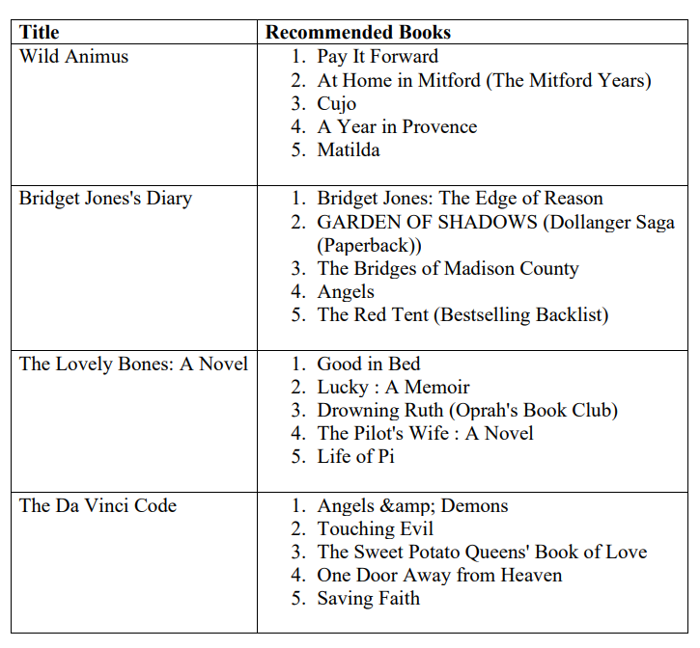
Book-book similarity
Finding similar books for USA country-
For this we checked cosine similarity between book titles.
Showing 5 similar books for 4 different titles.
Similarly can find for other countries and cities, for age groups as well.

Slide 27
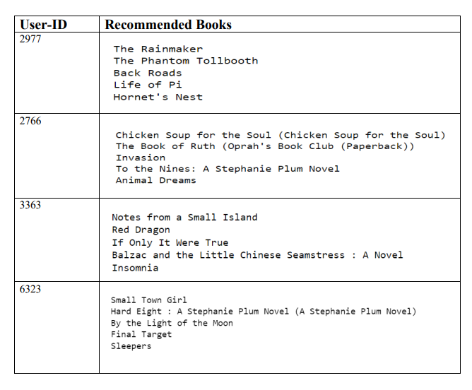
Type-1 b.book-book similarity
For this we checked cosine similarity between book titles
Showing 5 similar books for 4 User-Id’s
Its showing different books for user-id’s

Slide 28
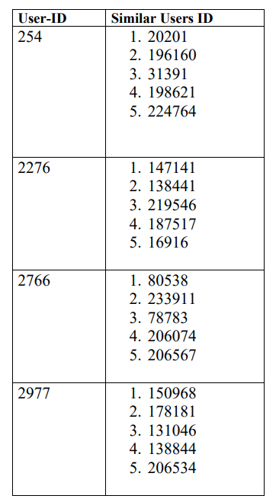
Type-2 user-user similarity
For this we checked cosine similarity between users.
Showing 5 similar users for 4 different User-ID’s

Slide 29
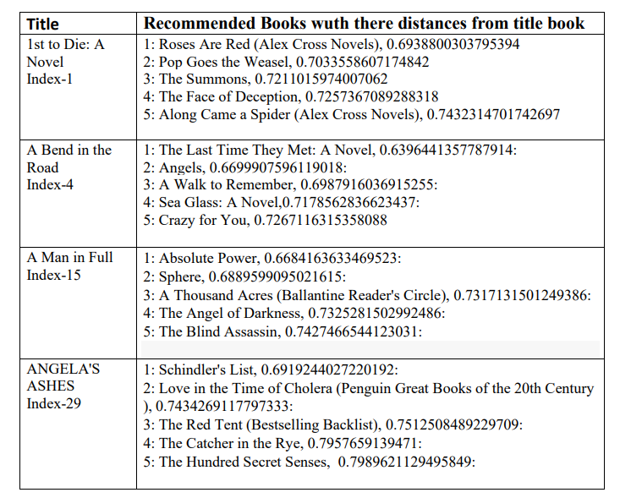
3.K-nearest neighbor
a. Finding similar books for USA country using Index No.-
For this we have used KNN with metric Cosine.
Used index no. here to find title.
Showing 5 similar books for 4 different titles.
Similarly we can find for other countries and cities, for age groups as well.

Slide 30
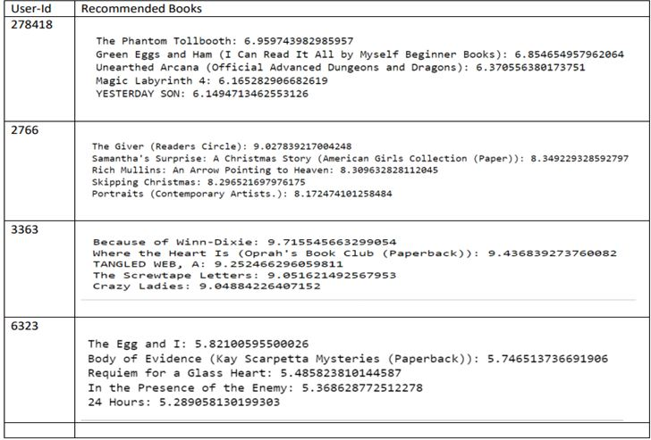
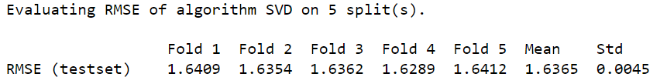
b. Finding similar books for USA country using User-Id-
For this we have used KNN with metric Cosine.
Used SVD from Surprise Library to find RMSE
Used index no. here to find title.
Showing 5 similar books for 4 different titles.
Similarly we can find for other countries and cities, for age groups as well.

Slide 31
Deployement

Slide 32
Streamlit web app
First step is to install Streamlit in either anaconda prompt or anaconda PowerShell prompt using the code “pip install Streamlit” based on your OS.
Go to prompt and enter the folder name where the file has been saved using “cd ‘folder name’” and run it.
Run the entire code using “streamlit run app.py” and we will get https web local host will be created.

Slide 33

After running the code the output is going to look like this
Enter the user id in the search bar to recommend the books

Slide 34

After entering the user id it is gonna recommend the books

Slide 35
Thank you
Team mate name | Mail-id | GitHub id
M.Anand kumar | anandkumarmamidinandu@gmail.com | https://gist.github.com/anand-kumar7755
Mrs. Pallavi | pallavivalluripalli222@gmail.com | https://github.com/PallaviSiripurapu/Pallavi
Dr.ruchika Jain | ruchikajain29@gmail.com | https://github.com/Ruchika2977
G.Srinu | srinuguddala1807@gmail.com | https://github.com/Srinu18/Srinu.git
Tushar Ranjan | tusharpanda350@gmail.com | https://github.com/Tusharpanda12/DS_Assighnmnets
Sanjeev | sanjeevsdm@gmail.com | https://github.com/sanjeev2190/DataScience-Program
Akash salve | Akash.salve9@gmail.com | https://github.com/Akki9295

